Slide 1
NUTRIENT DEFICIENCY IN PLANTS

Slide 2
INTRODUCTION
MINERAL NUTRIENTS ARE ELEMENTS acquired primarily in the form of inorganic ions from the soil.
Only way of entry of minerals in biosphere is through the roots of the plants.
After absorption mineral nutrient are transported to various locations in the plants where they are utilized in different processes.
The study of how plants obtain and use mineral nutrients is called MINERAL NUTRITION.

Slide 3
About 60 different elements have been reported in plants out of which 30 are present in all plants.
Out of 30, 16 elements are essential and rest are non-essential.
This essentiality and non-essentiality of the mineral elements is governed by CRITERIA OF ESSENTIALITY.

Slide 4
CRITERIA OF ESSENTIALITY
Given by Arnon and Stout in 1939.
It states that
A plant must be unable to grow in the absence of essential elements.
It must be irreplaceable, i.e. specific for a particular plant function.
It must be directly involved in the nutrition of the plants.

Slide 5
Essential mineral elements are usually classified as macronutrients or micronutrients, according to their relative concentration in plant tissue.
Macronutrients
Required by plants in larger quantities
C, H, O, N, P, K, S, Ca, Mg, Fe
Micronutrients
Required in small amounts
Cu, Zn, Mn, Mo, B, Cl

Slide 6
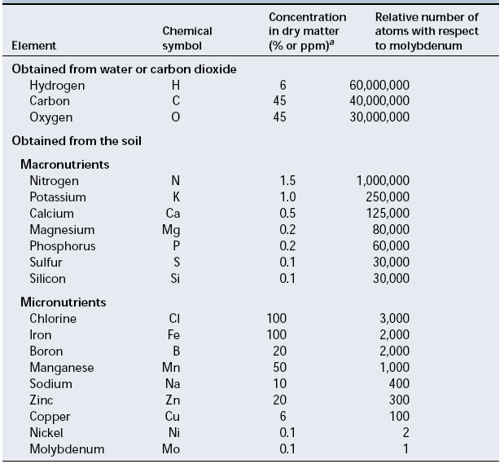
Table: Adequate tissue levels of elements that may be required by the plants.

Slide 7
The classification into macro and micronutrients is difficult to justify.
Hence they must be classified based on their biological role and physiological function.
Hence plant nutrients can be divided into four basic groups:
The first group of essential elements forms the organic (carbon) compounds of the plant. Plants assimilate these nutrients via biochemical reactions involving oxidation and reduction.

Slide 8
The second group is important in energy storage reactions or in maintaining structural integrity.
The third group is present in plant tissue as either free ions or ions bound to substances such as the pectic acids present in the plant cell wall.
The fourth group has important roles in reactions involving electron transfer.

Slide 9
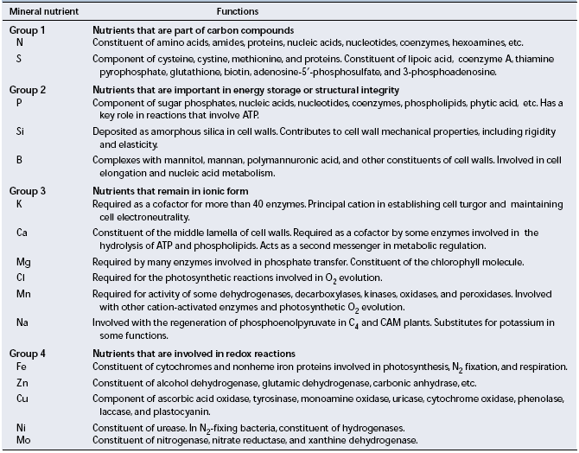

Slide 10
CHLOROSIS

Slide 11
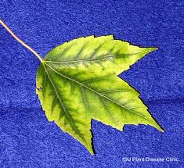

Slide 12
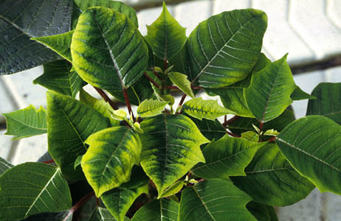

Slide 13
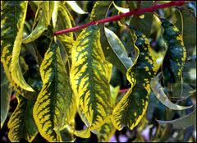

Slide 14
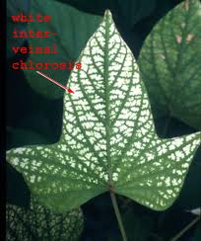

Slide 15
NECROSIS

Slide 16
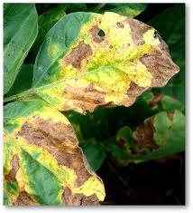

Slide 17
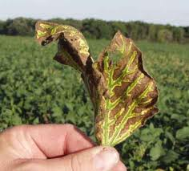

Slide 18
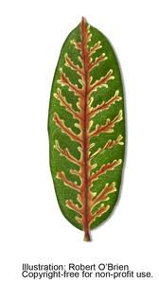

Slide 19
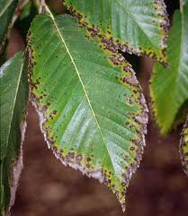

Slide 20
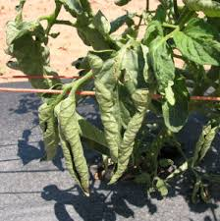

Slide 21
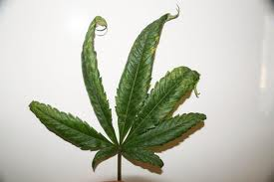

Slide 22
DEFICIENCIES OF GROUP 1 MINERAL ELEMENTS
Nitrogen
Required in greatest amount
Important for amino and nucleic acids
Deficiency inhibits plant growth
Severe deficiency can cause chlorosis and ultimately leaves die
Sulfur
Found in two amino acids and essential for metabolism
Symptoms include chlorosis, stunting of growth and anthocyanin accumulation
Chlorosis generally occur throughout the plant

Slide 23
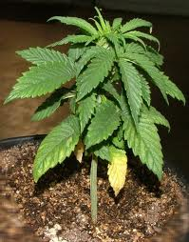

Slide 24
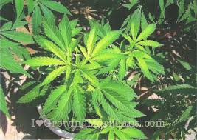

Slide 25
DEFICIENCIES OF GROUP 2 MINERAL ELEMENTS
Phopshorus
Characteristic symptoms of phosphorus deficiency include stunted growth in young plants
Dark green coloration of the leaves, which may be malformed and
Contain small spots of dead tissue called necrotic spots
Also include production of slender stem and death of older leaves.

Slide 26
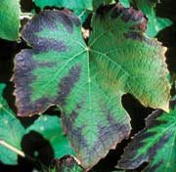

Slide 27
Silicon
Plants deficient in silicon are more susceptible to lodging (falling over) and fungal infection.
It also forms complexes with polyphenols and thus serves as an alternative to lignin in the reinforcement of cell walls.
In addition, silicon can ameliorate the toxicity of many heavy metals.
Boron
A characteristic symptom is black necrosis of the young leaves and terminal buds.
Stems may be unusually stiff or brittle.
Apical dominance may be lost.
Structures such as fruits and tubers exhibit necrosis.

Slide 28
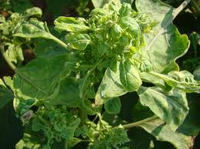

Slide 29
DEFICIENCIES OF GROUP 3 MINERAL ELEMENTS
Potassium
Marginal chlorosis
Dying of leaf tip
Appear at mature leaves
Stem is slender and weak with abnormally short internodes.
Calcium
Necrosis of young meristamatic regions
Downward hooking of young leaves
Root system appear brownish, short, and highly branched.
Severe stunting may result.

Slide 30
Magnesium
Chlorosis between leaf veins.
Leaves may become yellow or white.
It may also lead to premature abscession.
Chlorine
Required in oxygen evolution in photosynthesis.
Deficiency starts with wilting of leaf tip and proceeds to general necrosis of leaves.
Leaf growth is reduced.
Leaves appear bronze in color.
Roots of chlorine deficient plants are stunted.

Slide 31
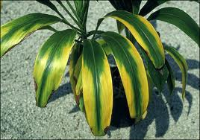

Slide 32
Manganese
Main symptom is intervenous chlorosis associated with development of small necrotic spots.
Sodium
C4 and CAM plants require Na ions.
Required for regeneration of PEP.
Under Na deficiency flowering fail to occur in these plants.

Slide 33
DEFICIENCY OF GROUP 4 MINERAL ELEMENTS
Iron
Intervenous chlorosis in younger leaves.
After some time leaf starts to turn white.
Zinc
Reduction in internodal growth.
Plant shows rosette habit of growth.
Leaves are small and distorted.
Leaf margins usually have a puckered appearance.

Slide 34
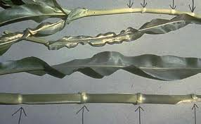

Slide 35
Copper
Also involve in electron transfer reactions eg. Plastocyanin.
Initial symptom of Cu deficiency is production of dark green leaves with development of necrotic spots.
Necrotic spots generally spread along margins.
Leaves also appear twisted and malformed.
Premature abscision of leaves may occur.
Nickel
Nickel deficiency in plants leads to accumulation of user in their leaves.
Leaf tip necrosis is also observed.

Slide 36
Molybdenum
The first indication of a molybdenum deficiency is general chlorosis between veins and necrosis of the older leaves.
Molybdenum deficiency can also lead to nitrogen deficiency.

